Slide 1
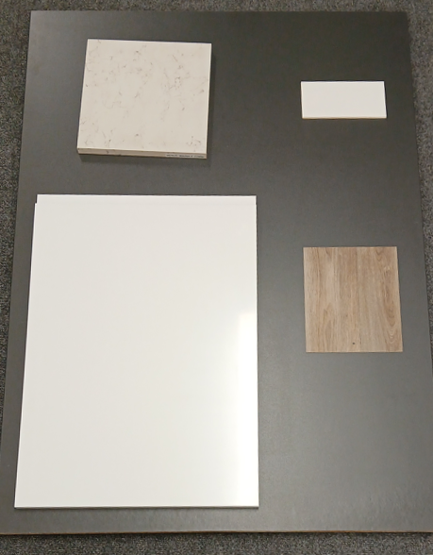
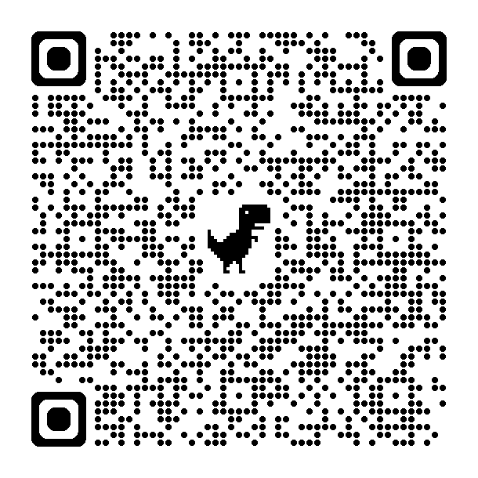
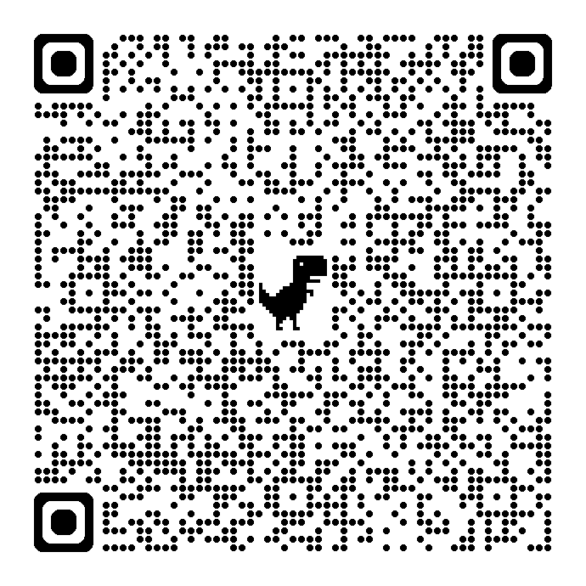
Social Rent
Kitchen option 1
Default Option
Kitchen Splashback – Johnson tiles 100mmx200mm laid horizontally PRS12 White satin finish, matching Grout
Kitchen Worktop– Howdens Venus Marble Worktop 22mm thick Wok 8960
Kitchen Flooring – Isafe 70 vinyl sheet flooring (Wood Plank Design) Colour Tavel / Vintage Oak 530
Kitchen Units – Howdens Clerkenwell Super Matt range – White

Slide 2
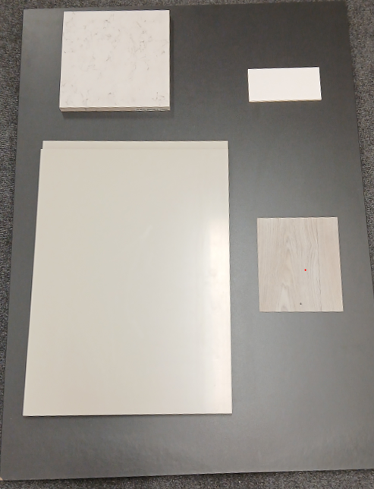
Social Rent
Kitchen option 2
Kitchen Splashback – Johnson tiles 100mmx200mm laid horizontally PRS12 White satin finish, matching Grout
Kitchen Worktop– Howdens Venus Marble Worktop 22mm thick Wok 8960
Kitchen Flooring – Isafe 70 vinyl sheet flooring (Wood Plank Design) Colour Stockholm / Studio 595
Kitchen Units – Howdens Clerkenwell Super Matt range - Pebble

Slide 3
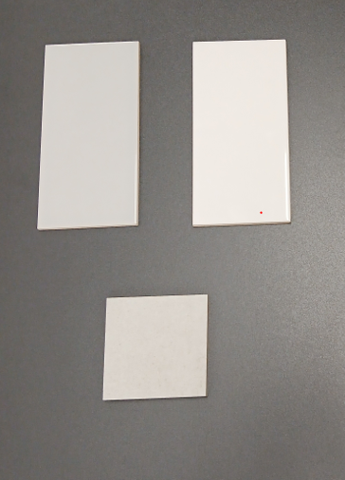
Social Rent
Bathroom option 1
Default Option
Wall Tiling -100mm x 200mm laid horizontally PRG1 White, Gloss finish matching Grout
Floor Tiling – Hudson Range 300mm x 300mm laid horizontally HUDS1N Albany White matching Grout
Feature Wall Tiling - 100mm x 200mm laid horizontally PRG11 Shark, Gloss finish matching Grout

Slide 4
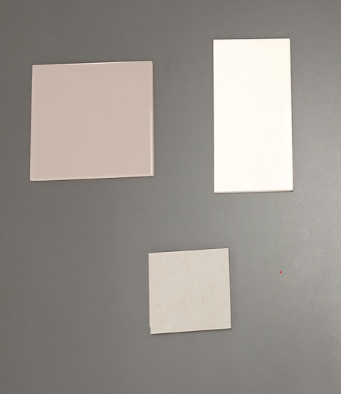
Social Rent
Bathroom option 2
Wall Tiling -100mm x 200mm laid horizontally PRG1 White, Gloss finish matching Grout
Floor Tiling – Hudson Range 300mm x 300mm laid horizontally HUDS3N Manhattan matching Grout
Feature Wall Tiling -100mm x 200mm laid horizontally PRG09 Woodpigeon, Gloss finish matching Grout

Slide 5
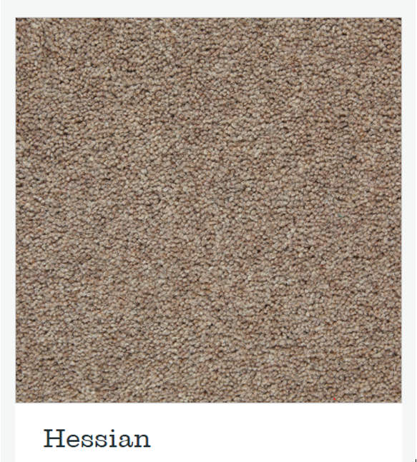
Social Rent
Flooring to Bedrooms Option 1
Kendall Twist Carpet – Hessian

Slide 6
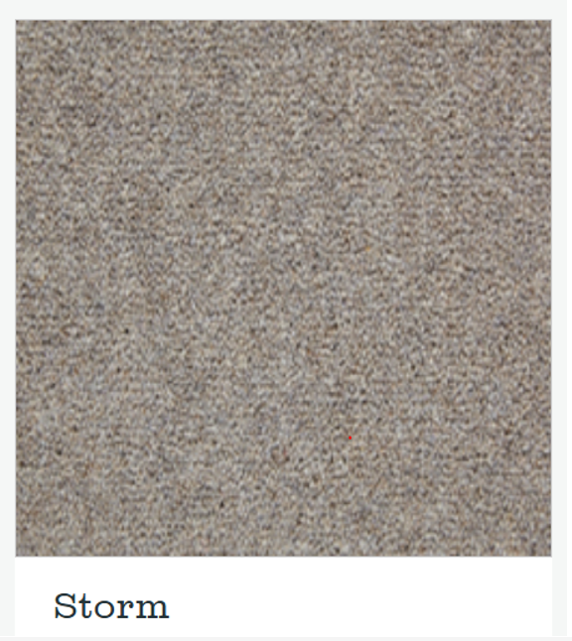
Social Rent
Flooring to Bedrooms Option 2
Kendall Twist Carpet – Storm

